Slide 1




ENGLISH 8
COUNTRY LIFE AND CITY LIFE
LISTEN AND READ

Slide 2

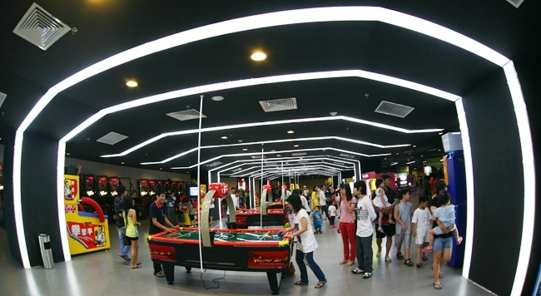

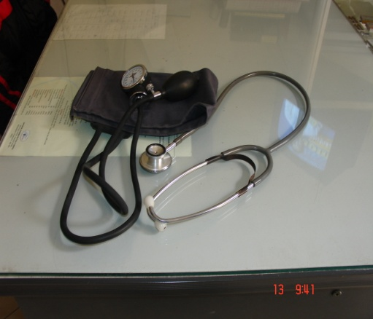
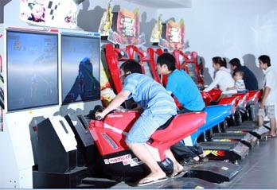

UNIT 8: COUNTRY LIFE AND CITY LIFE
Listen and read
I. New words
mãi mãi, lâu dài
1. permanent (adj):
→ permanently(adv):
giải trí
2. entertain (v):
→ entertainment (n):
sự giải trí
3. accessible (adj)
: có thể tiếp cận được
4. medical facilities :
thiết bị y tế
5. change (v/n)
: thay đổi, sự thay đổi
6. definitely (adv)
: nhất định

Slide 3
UNIT 8: COUNTRY LIFE AND CITY LIFE
Listen and read
Grammar
* Examples:
1.Many remote areas are getting electricity.
2. Life in the provinces is changing for the better.
*Note: The present progressive tense
S + am/is/are + V-ing…
➔ talking about changes
(Dùng thì hiện tại tiếp diễn để nói về sự thay đổi)

Slide 4

Hoa: Hi, Na. Have you been away?
Na: Yes. I went to the countryside for the weekend.
Hoa: Where did you go?
Na: I went to Kim Lien. It’s a village. Some of my relatives live there.
Hoa: I’ve heard it’s a beautiful place.
Na: It is. And it’s very quiet and peaceful. I had a really nice weekend, but I don’t want to live there permanently.
Hoa: Why not?
Na: It’s too quiet. There is nothing to do.
Hoa: Yes, but things are changing in the countryside.
Na: Such as?
Hoa: Many remote areas are getting electricity. People can now have things like refrigerators and ...
Na: And TV.
Hoa: That too. TV is bringing not only information but also entertainment. And medical facilities are more easily accessible too. Life in the provinces is definitely changing for the better.
Na: But the city has so much more to offer.
Hoa: In many ways, I prefer the countryside. Life is simple, people are friendly and the air is clean.

Slide 5

Ask and answer the questions:
a. Where has Na been?
→ She has been to the countryside.
b. How long was she there?
→ She was there for two days.
c. What is her opinion of the countryside?
→ She thinks the countryside is peaceful and quiet.

Slide 6
Ask and answer the questions:
d. Na says ,“ There is nothing to do”. What does she mean by this?
→ Maybe she means that there are no libraries, no movies, no supermarkets, no zoos…, so there is nothing to do.
e. What are some of the changes that Hoa mentions?
→ Many remote areas are getting electricity, people in these areas now have refrigerators and TV. And medical facilities are more easily accessible.

Slide 7
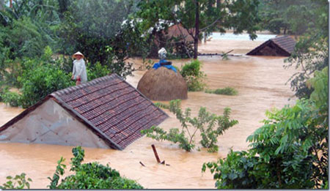
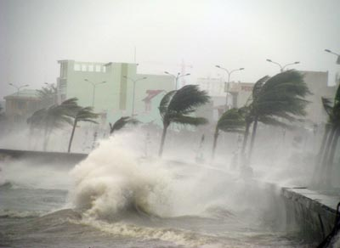
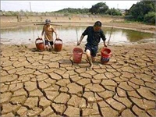
Unit 8. Country life and city life Lesson 4: Read
Vocabulary
- typhoon
(n) :
traän baõo lôùn
- flood
(n) :
traän luït
(n) :
naïn haïn haùn
- drought
(n) :
söï ñaáu tranh
- struggle
- strain
(n) :
söï quaù taûi (daân soá)
(n) :
daân di cö
- migrant
- increase
(v) : gia taêng

Slide 8
READ
Many people from rural areas are leaving behind their traditional
way of life and moving to the city. They believe that well-paying jobs
are plentiful in the city.
At home on the farm, life is always a struggle with nature. Typhoons,
floods or droughts can easily destroy a harvest and leave the farmer
with little or no money until the following year. Often farmers look
for other work when they need more money for their family.
The increase in population, however, has led to overcrowding in
many cities. This puts a strain on schools and hospitals, as well as
water and electricity supplies. Increased pollution is another
unpleasant result.
There is also a human side to this tragedy. Families sometimes have
to live apart. In these cases, children may live at home with relatives,
while their parents go and live in an urban area.
Governments all over the world are trying to provide facilities for
these migrants, but it can be quite a problem.

Slide 9

Matching
1. rural area
a. sèng c¸ch xa nhau
b. dÉn ®Õn sù qu¸ t¶i
2. a well-paying job
c. vïng n«ng th«n
3. urban area
d. c«ng viÖc ®­îc tr¶ l­¬ng cao
4. (to) live apart
5. (to) put a strain on
e. cuéc ®Êu tranh víi thiªn nhiªn
6. overcrowding (n)
g. vïng ®« thÞ
7. a struggle with nature
h. qu¸ ®«ng ng­êi

Slide 10
1. Complete the summary. Use information from passage.
leaving
People from the countryside are (1) ________ their (2) _______ to go and
live in the (3)________. Farming can sometimes be a difficult life and
these people from (4) __________ areas feel the (5) ________ offers
more opportunities. However, many people coming to the city create
(6)_________ . There may not be enough (7) ________ or (8) __________,
while water and electricity supplies may not be adequate. This is
a (9)__________ facing governments around the (10) ______ .
home
city
rural
city
problems
schools
hospitals
problem
world

Slide 11
2. Find the word in passage that means:
rural
a) of the countryside =
b) as many as needed =
c) become greater or larger =
d) a great pressure =
e) a terrible event =
f) of the city or city life =
plentiful
increase
strain
tragedy
urban

Slide 12
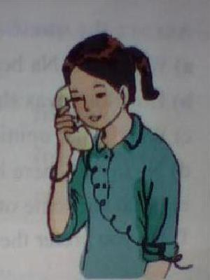
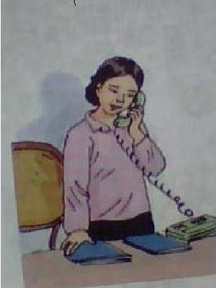
II. Listen
1.Listen and fill in the missing words.
Lan: Hello.
Aunt Hang: Hello. Is (1)________Lan?
Lan Yes. Who is (2)________?
Aunt Hang: (3)______Aunt Hang. How are you?
Lan: I’m fine.(4)________are you phoning(5)________?
Aunt Hang: Hue. I’m calling to tell you Uncle Chi and I are (6)________to
visit you next (7)________.
Lan: Great! When are you (8)________?
Aunt Hang: On (9)________. We’re arriving in Ha Noi in the (10)________
(11) ________
Lan: OK. Do you want to (12)________to(13)________mom?
Aunt Hang: Yes, please.
Lan: Hold on a moment and I’ll (14)________her.
that
this
It's
LAN
Where
from
coming
week
arriving
Thursday
late
afternoon
speak
my
get
Aunt HANG

Slide 13

Statement | Check
1. Aunt Hang is phoning Lan from Ha Noi
F
Hue
2. Aunt Hang and Uncle Chi are going to visit Lan
next week
T
3. She is arriving in Ha Noi on Thursday
in the early morning
F
late afternoon
4. She wants to speak to Lan’s mother
T

Slide 14

HOMEWORK
Learn the new words and structure by heart
Practice reading the dialogue, the reading
3. Prepare unit 8 (cont.) Language focus

